Slide 1
INTRO TO SQL
CREATED BY KISHORE

Slide 2
THE STORY OF SQL
Imagine the late 1960s.
Big corporations like IBM were storing more and more data — sales, customers, inventory — but the problem was: how do you find what you need quickly?

Slide 3
THE STORY OF SQL
Back then, data was stored in complicated file systems.
If you wanted a simple answer, like “Which customers bought product X last month?”, programmers had to write long, complex programs in languages like COBOL or assembly.
It was slow, rigid, and not something business people could do on their own.

Slide 4
THE STORY OF SQL
Enter Dr. Edgar F. Codd, an English computer scientist working at IBM.
In 1970, he published a groundbreaking paper introducing the idea of a relational model of data.

Slide 5
👉 His vision was simple but revolutionary:
Instead of thinking of data as tangled files, imagine them as tables (like spreadsheets).
And you could use math-like operations to connect, filter, and combine those tables.
This was like turning chaos into order.

Slide 6
👉 His vision was simple but revolutionary:
But there was still a challenge: how could humans actually talk to these relational databases?
That’s where Donald Chamberlin and Raymond Boyce, also at IBM, came in.

Slide 7
👉 His vision was simple but revolutionary:
In the mid-1970s, they created a new language called SEQUEL (Structured English Query Language).
The idea was to let people ask questions in something close to plain English:

Slide 8
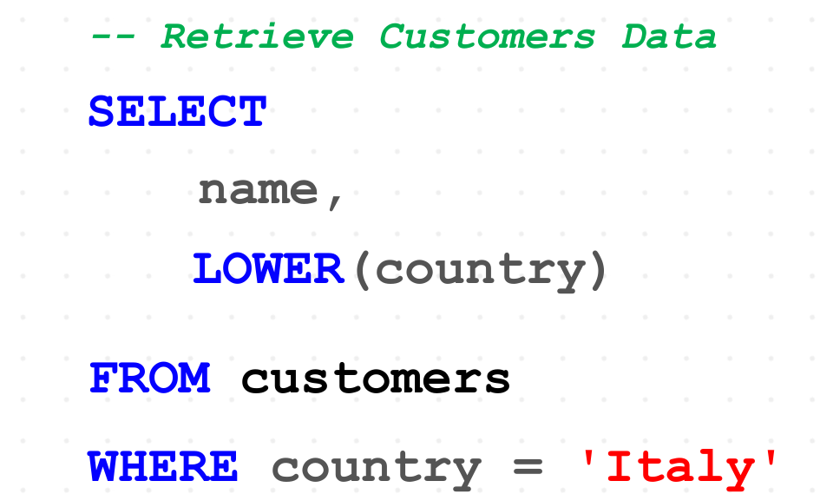
👉 His vision was simple but revolutionary:

Slide 9
👉 His vision was simple but revolutionary:
This was much easier to learn than traditional programming. Later, the name was shortened to SQL (Structured Query Language).
By the 1980s, companies like IBM, Oracle, and Microsoft adopted SQL, and it became the universal language of databases. Today, whether you’re booking a flight, scrolling through Instagram, or checking your bank balance — somewhere behind the scenes, SQL is running the show.

Slide 10
👉 His vision was simple but revolutionary:
✅ So in short, SQL was born out of a real-world need to make data easier to understand and use, evolving from Dr. Codd’s theory into the practical language we all use today.

Slide 11
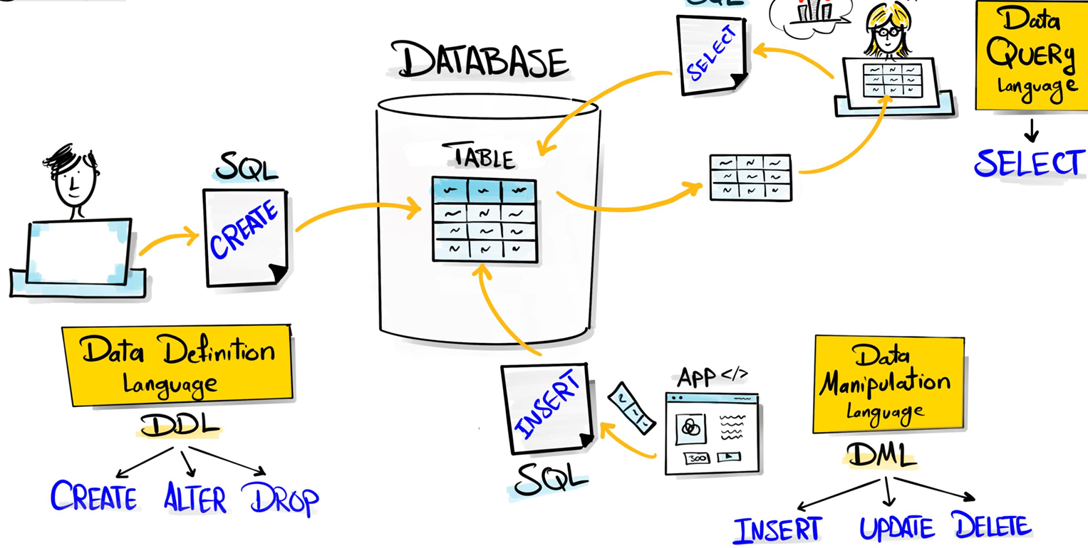

Slide 12
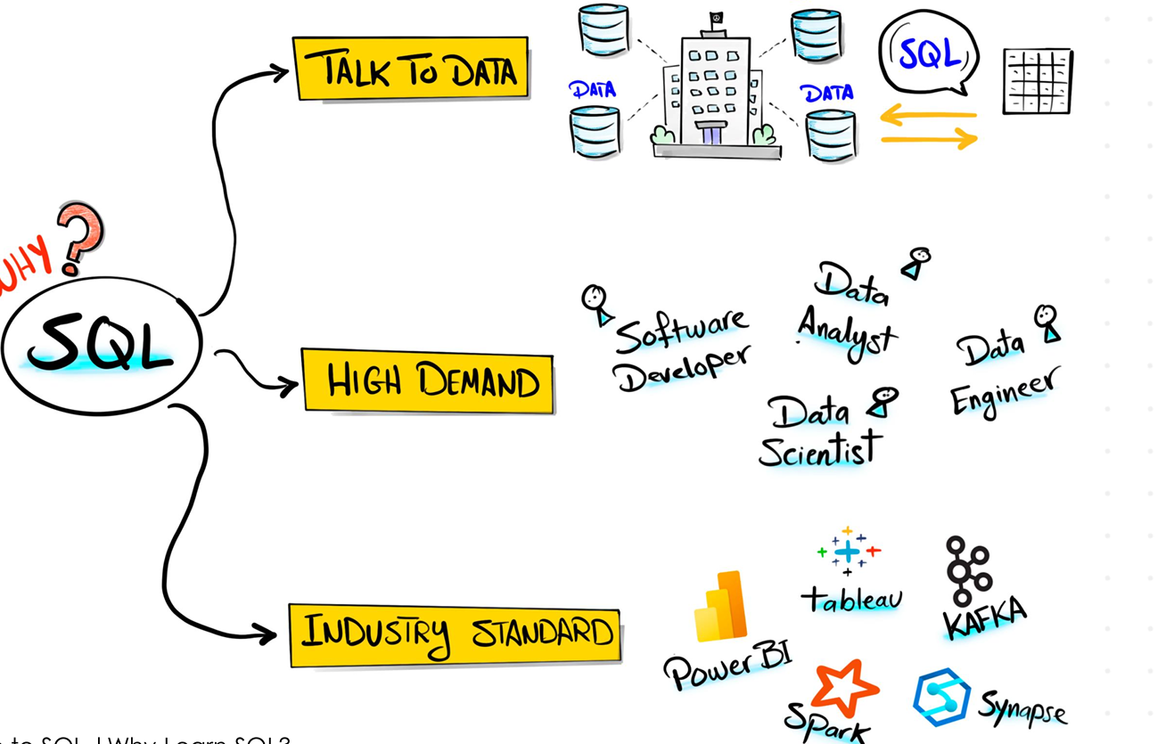

Slide 13


Slide 14
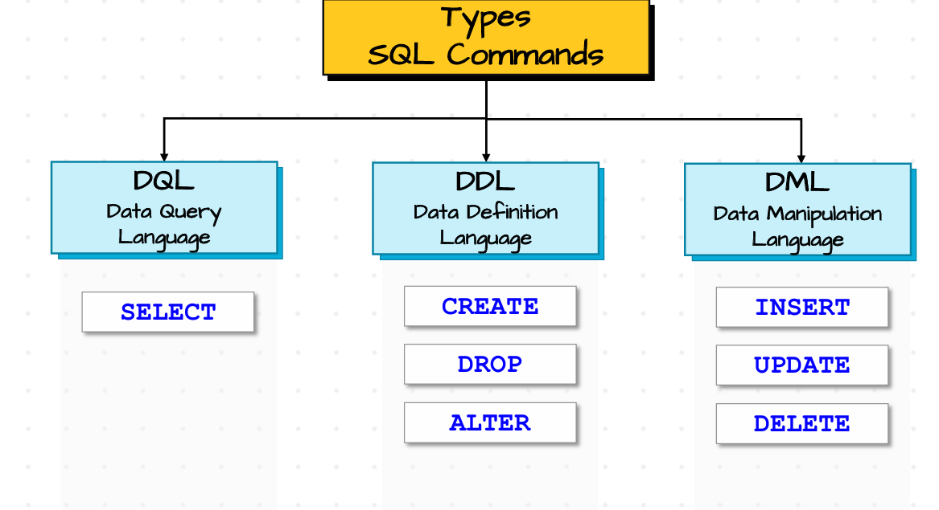

Slide 15
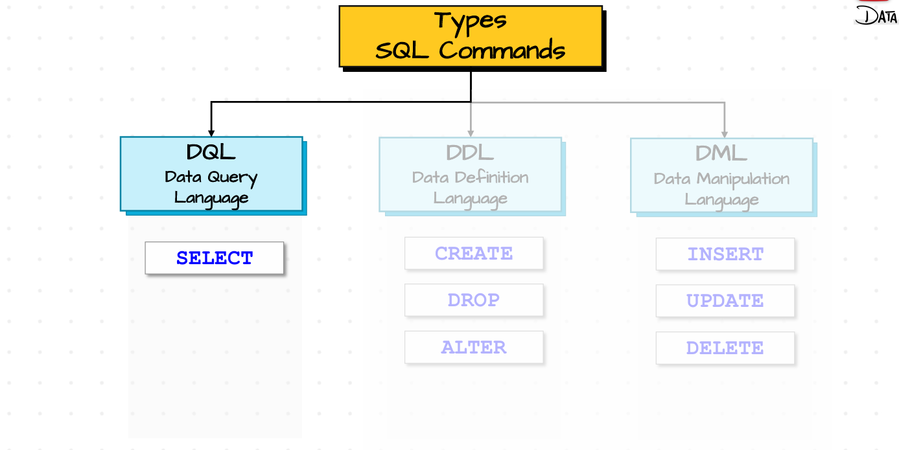

Slide 16
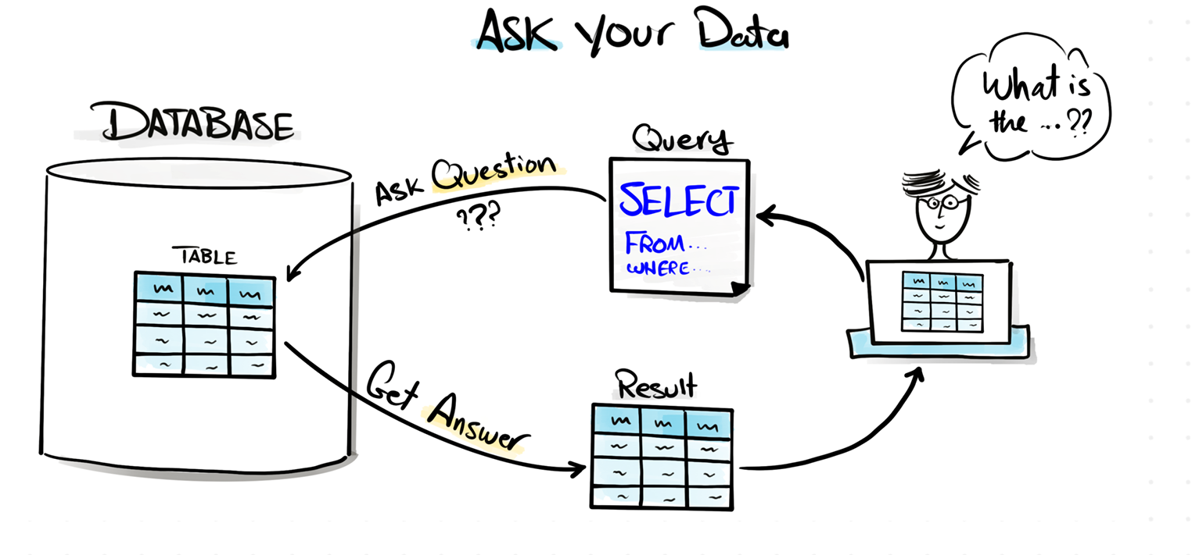

Slide 17
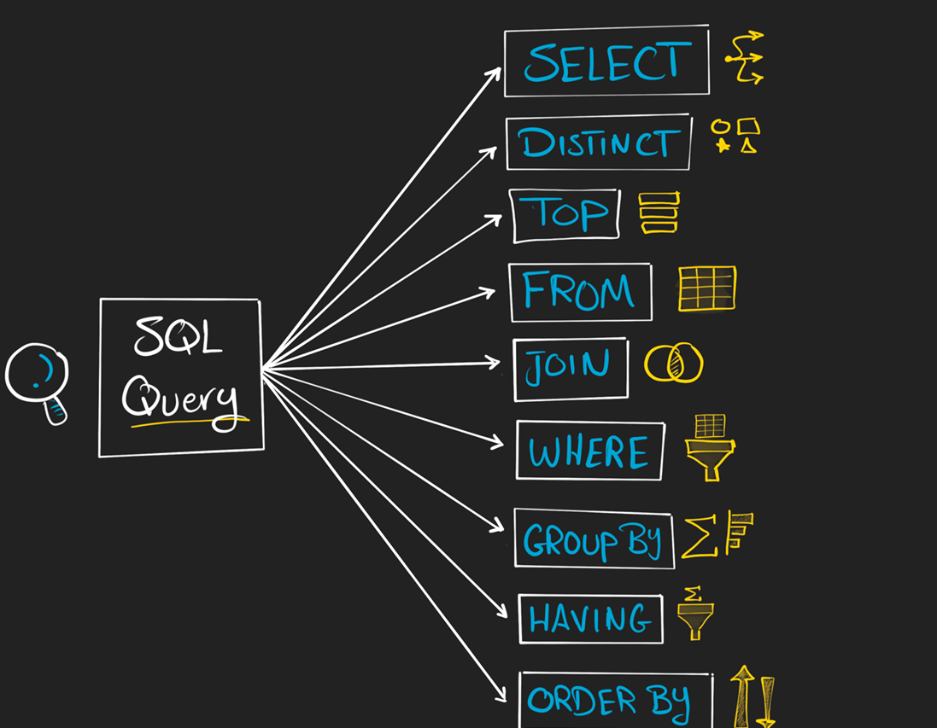

Slide 19
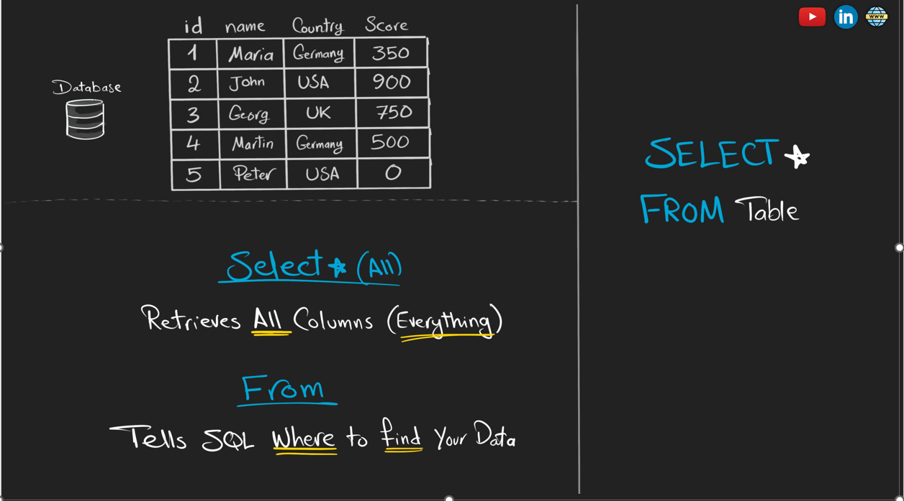

Slide 20
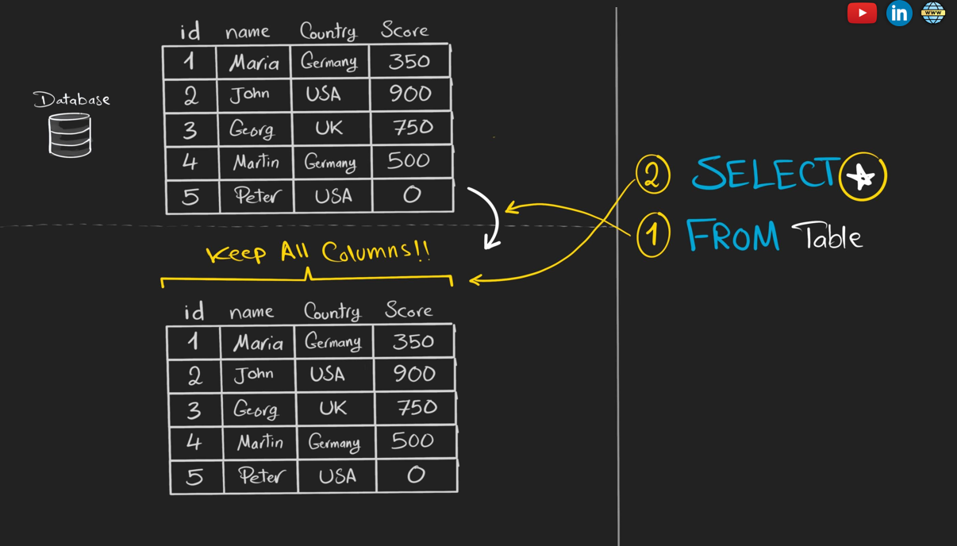

Slide 21
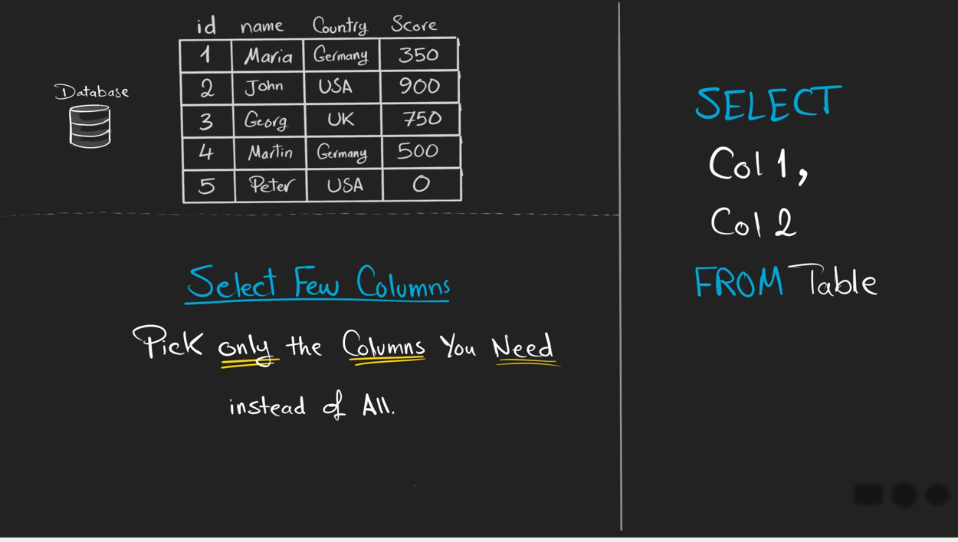

Slide 22
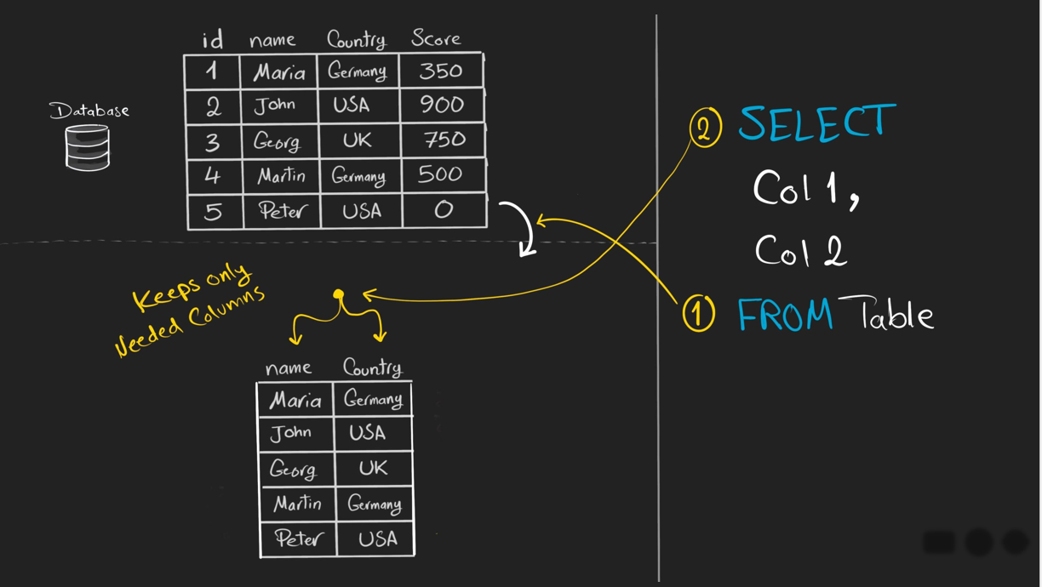

Slide 23
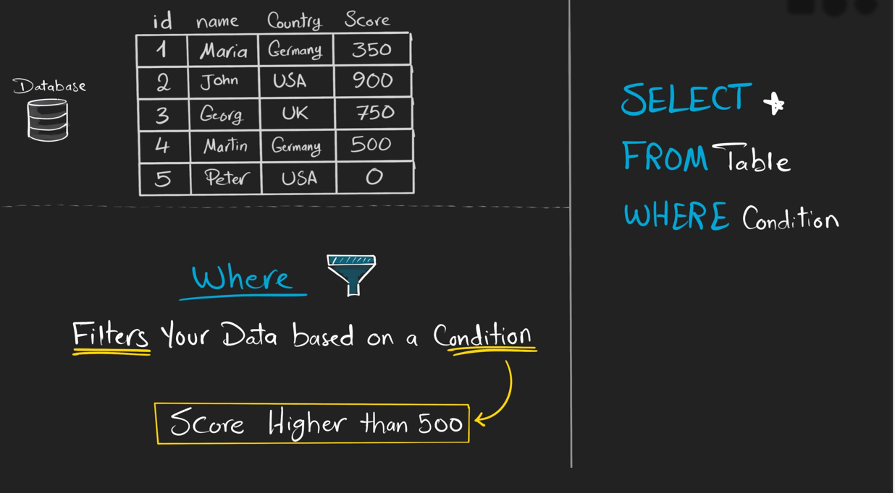

Slide 24
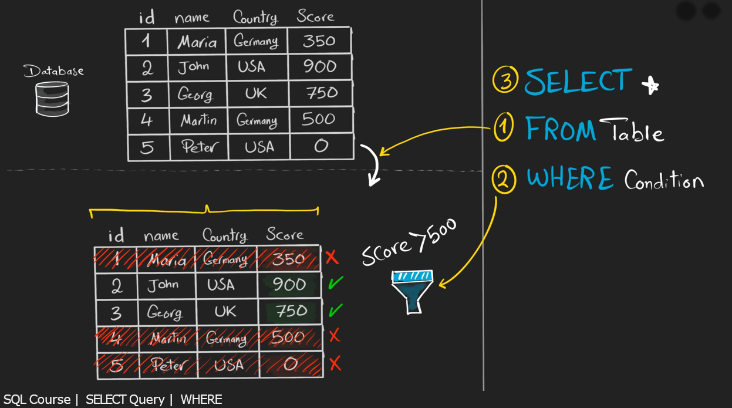

Slide 25
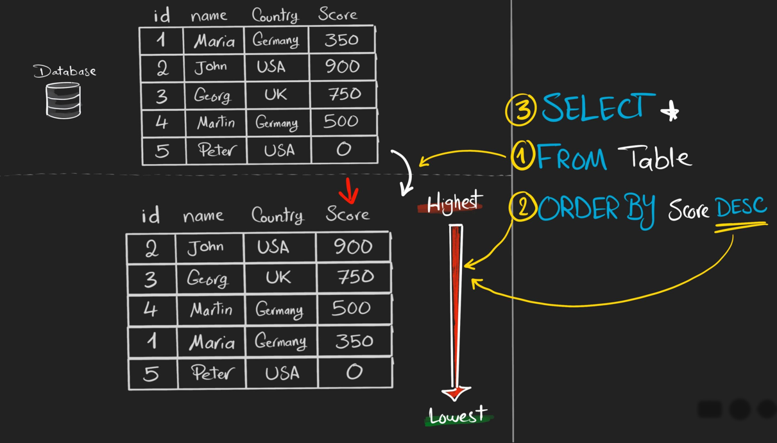

Slide 26
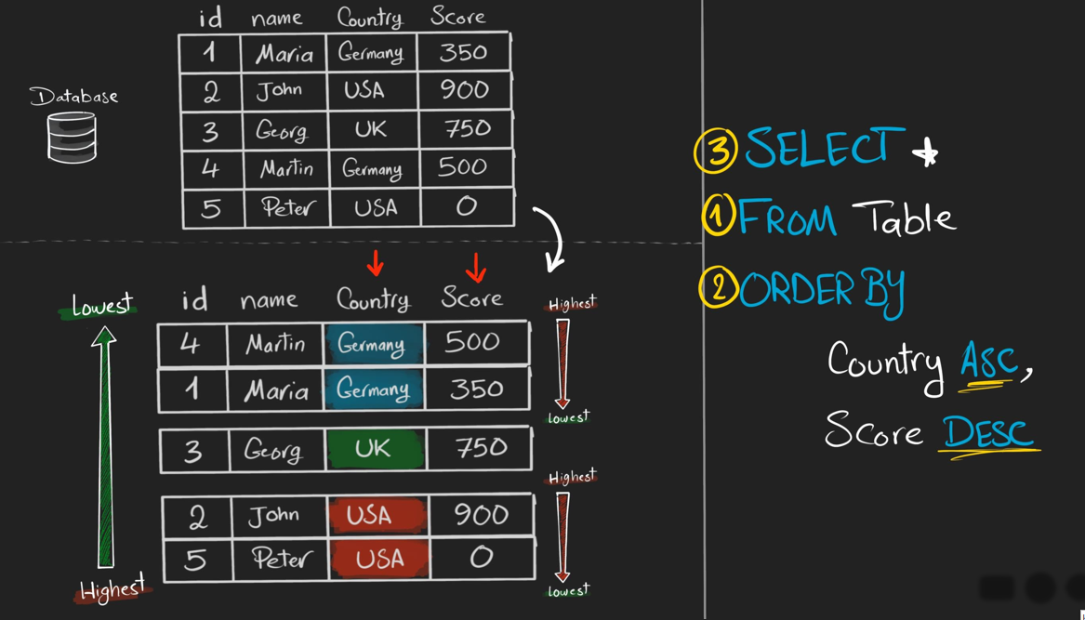

Slide 28
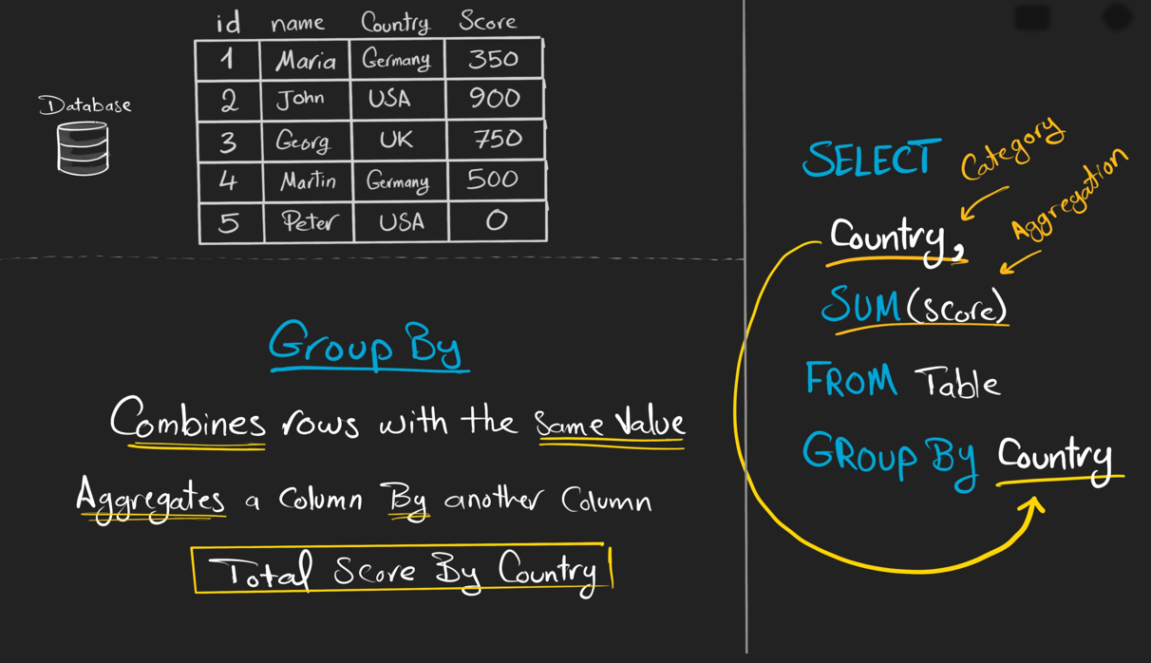

Slide 29
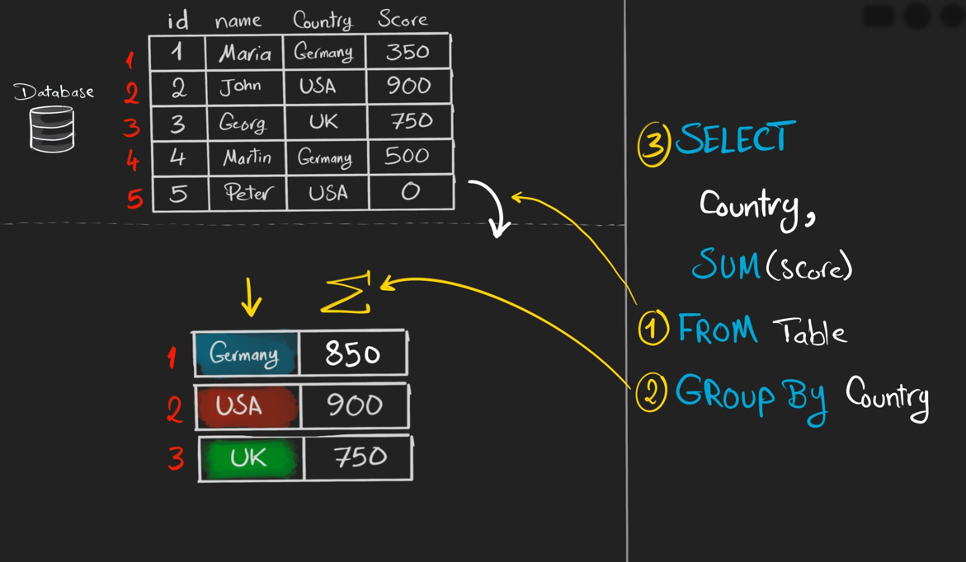

Slide 30
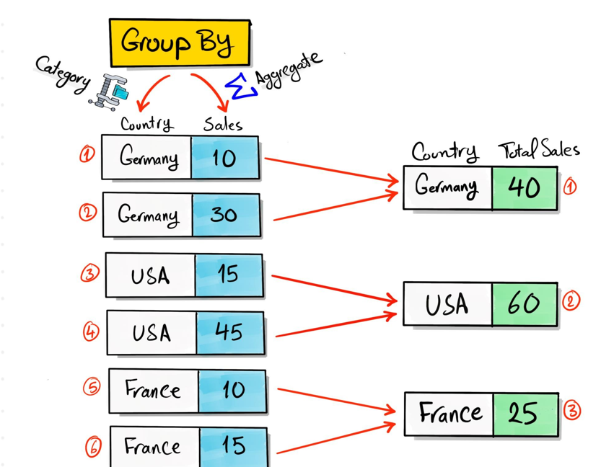

Slide 31
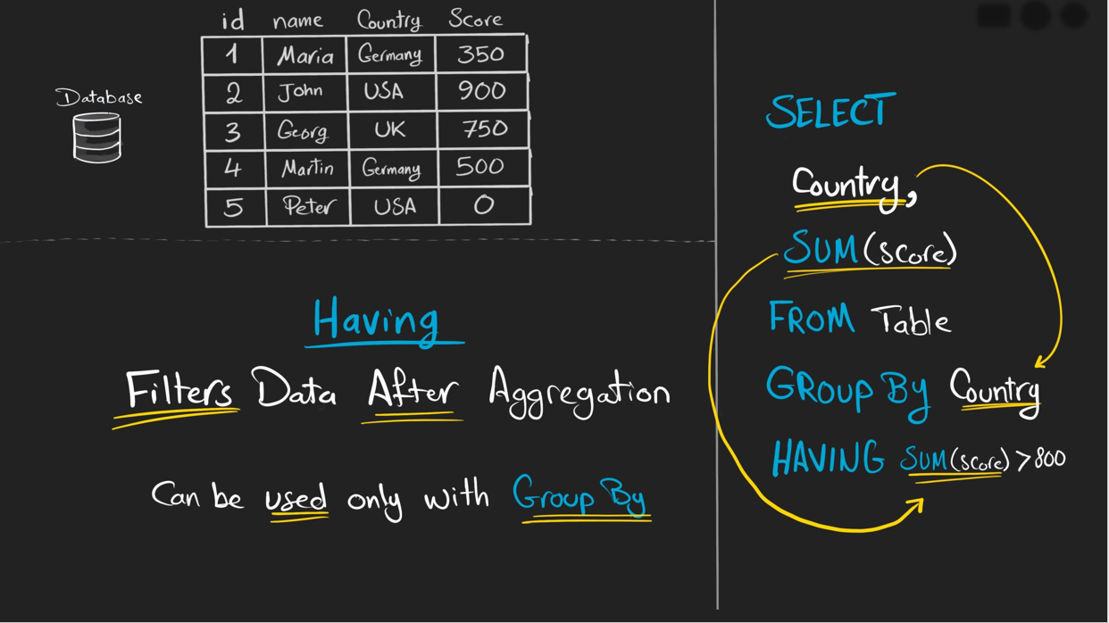

Slide 32
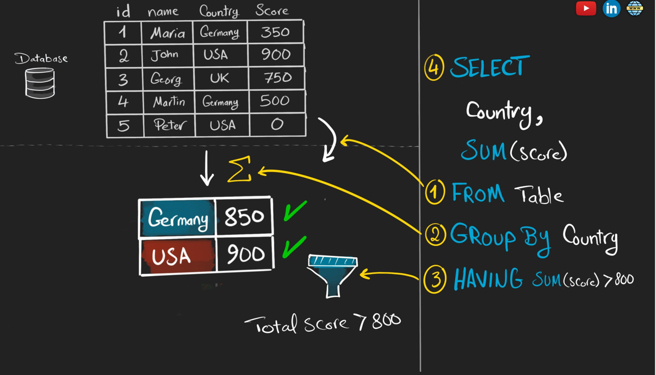

Slide 33
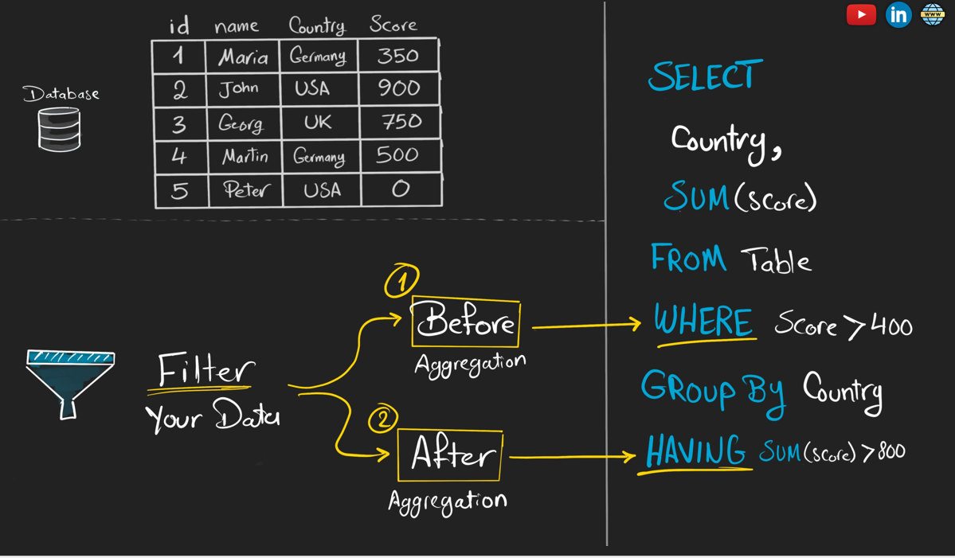

Slide 34
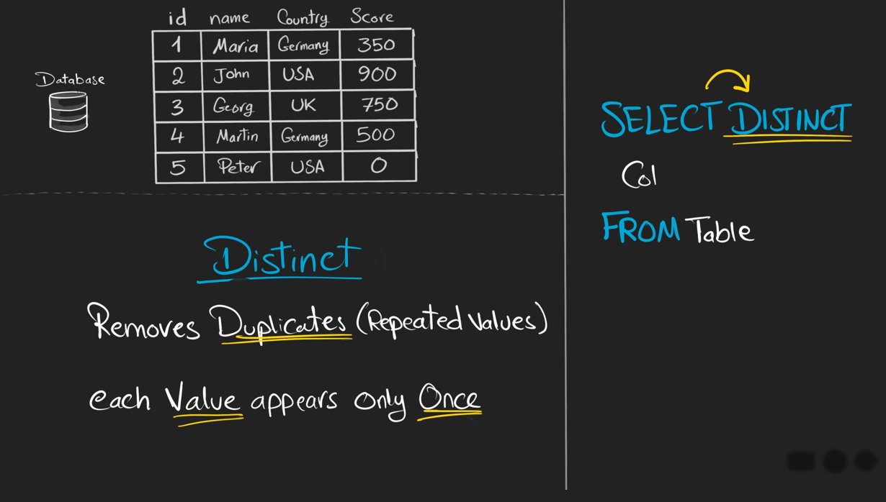

Slide 35
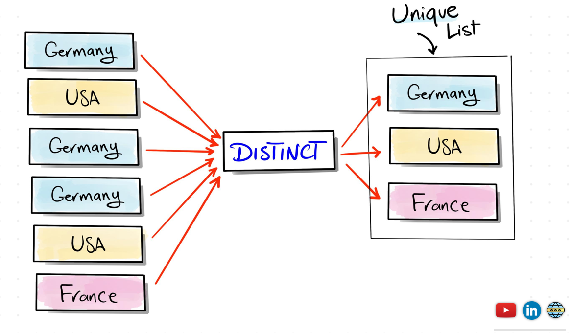

Slide 36
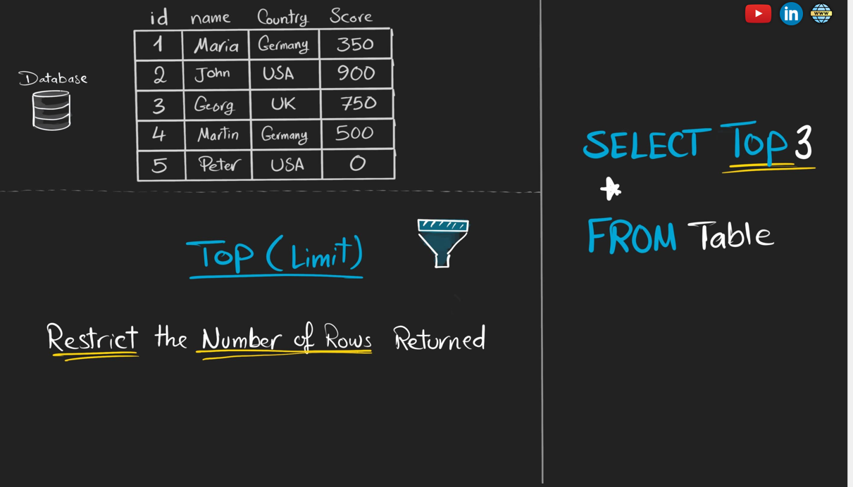

Slide 38
